Slide 1
Ý tưởng
Tìm ra nốt cha (parent) và nốt con cần xóa (current).
Có 3 trường hợp:
  Nút lá
  Nút 1 con
  Nút 2 con

Slide 2
Tìm ra nốt cha (parent) và nốt con cần xóa (current).

Slide 3
parent
parent
current
current
current

Slide 4
Node 0 con

Slide 5
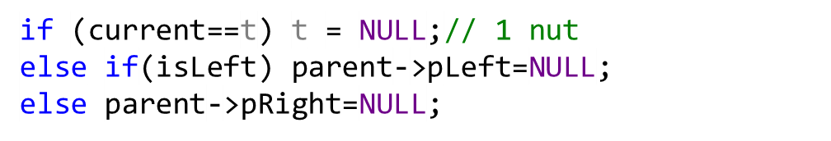
current
parent
parent
parent
current
current

Slide 6
Node 1 con

Slide 7
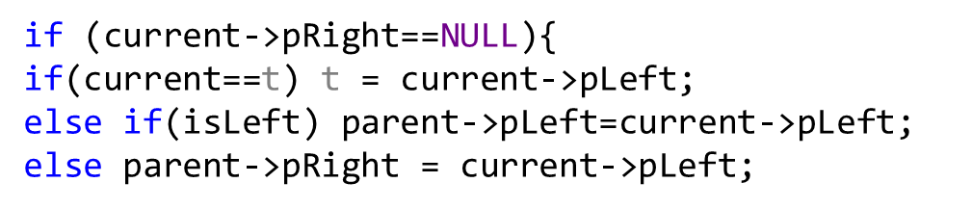
t
current
parent
parent
parent
current
current

Slide 8
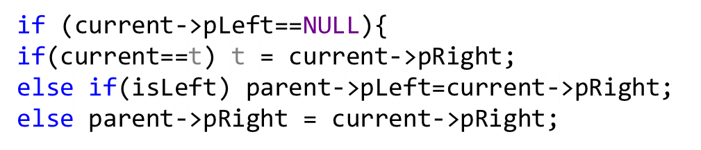
t
current
parent
parent
parent
current
current

Slide 9
Node 2 con

Slide 10

Tìm node thay thế
parent
current
current->right
S

Slide 11

t = temp
t
current
temp
current->right
S

Slide 12
parent
current
current->right
S

Slide 13
parent
current
current->right
S

Slide 14
(current->right)->left=S->left
parent
S->right=current->right
S->left=current->left
current
temp
temp=S
current->right
parent->left=temp
S

Slide 15
parent
(current->right)->left=S->left
S->right=current->right
S->left=current->left
current
temp
temp=S
current->right
parent->right=temp
S

Slide 16
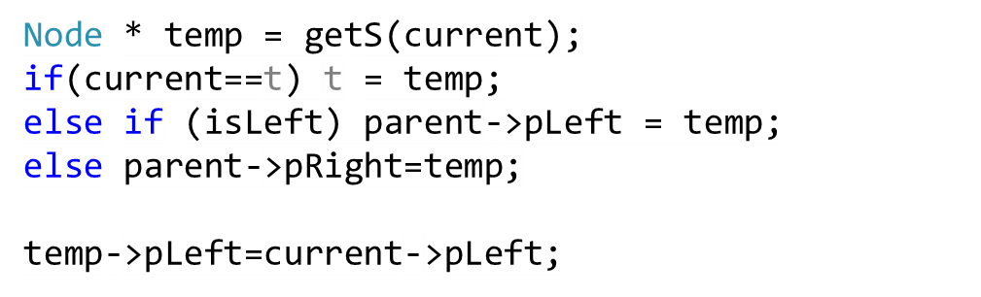
parent
current
temp
current->right
S

Slide 17
Thank you

